Slide 1
Trip Leader Meeting
2023 Trips & Beyond

Slide 2
Table of contents
01
02
03
04
Objectives
Expectations
Why we take trips
The role of trip leader
Trip Timeline
Looking forward
Covering planning and policies

Slide 3
01
Objectives

Slide 4
Our Purpose
To mobilize every member of Shandon to live in full obedience to the Great Commission and their unique roles in it.

Slide 5
Our Missions Convictions
1. Advance the gospel
2. Pray for power
3. Move with the Holy Spirit
4. Send our people
5. Care for our missionaries
6. Prioritize strategic partners
7. Empower national leaders
8. Plant multiplying churches
9. Love our city
10. Bring light to darkness

Slide 6
Mission Trip Goals
Be with Jesus
Love your team
Serve our partners

Slide 7
Being with Jesus
Prayer
Scripture
Obedience
Thanksgiving
Rely on God
Ask for opportunity
Daily time in the Word
Knowing God’s Desire for the nations
Each day is successful if you walked with Jesus not if everything went to plan
How can I grow as a Friend and Follower of Jesus?

Slide 8
Loving Your Team
Community
Discipleship
Serving One Another
Building lasting relationships
Having fun together
“Helping one another follow Jesus”
Caring for each others needs
Sacrificing your preferences
How can we grow as members of the Family of God?

Slide 9
Serving Your Partner
Look to Their Interests
Gifts
Submit to Them
Listen to their stories
Speak encouragement
Care for their children
Pray with them
Think about bringing gifts that may serve them
Let the Missions team know
Even if you disagree, submit to your partner
Speak to Missions staff about any concerns
How can we grow as Fishers of Men?

Slide 10
2
Expectations

Slide 11
Expectations
Stewardship
Recruiting
Communication
Spiritual Guidance
Missionary Advocacy
Raising Up Leaders

Slide 12
Stewardship
Managing what belongs to God for the sake of His purposes
Not just “saving money,” but using it effectively
“Does this effort support our objectives for mission trips?”
More on budgeting later

Slide 13
Recruiting
Building a team that can accomplish our objectives
We want them to be FAT
Faithful
Available
Teachable
More on recruiting later

Slide 14
Communication
Keeping everyone on the same page
Ensuring deadlines are met
Answering questions as they arise

Slide 15
Spiritual Guidance
Helping your team follow Jesus
Comforting through discomfort
Applying biblical truth on mission
Cast vision for the life of a “Global Christian”

Slide 16
Missionary Advocacy
Caring for the missionary (or partner)
Communicating their needs to the Missions staff and church
Gathering information about future sending opportunities (short term and long term)
Missions staff (and pastors) make the final decisions, but your input is vital

Slide 17
Raising Up Leaders
Identify future leaders and give them opportunities to grow
What is a future missions leader?
Future trip leader
Future missionary
Potential to serve in a greater capacity at home

Slide 18
3
Trip Timeline

Slide 19
The timeline
Preparation
Debrief
Getting the team ready
What has God taught us?
01
02
03
04
Pre-launch
Trip
Understanding the trip
Being sent

Slide 20
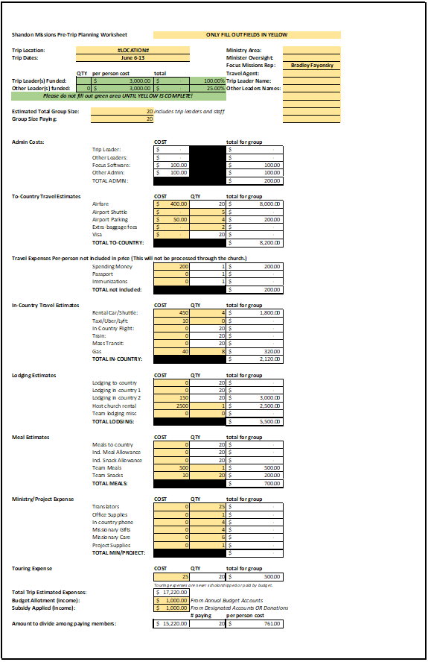
Budget Planning
How can I prepare a budget?
Use costs from similar trip
Conservatively estimate flight costs (easier to discount than to mark-up)
Ask the field partner
Use the budget planner

Slide 21
Budget Planning
Trip Leader Funding
Less than 5 members: ½ scholarship for leader
5 – 15 members: full scholarship for leader
15 – 20 members: full scholarship for leader, ½ for assistant leader
20 plus members: full scholarship for both leader and assistant leader

Slide 22
Budget Planning
Travel Insurance
Through MissionSafe
Purchased by Missions Staff
Covers medical liability while overseas

Slide 23
Budget Planning
Expenses not included
Cell phone bills
Souvenirs
Passports
Immunizations
Meals in transit
Individual travel to airport
Unbudgeted tipping

Slide 24
Recruiting your team
“Shoulder Tapping”
1. Identify potential trip participants
Experienced members
OR Ready for the next step
2. Challenge them to go
3. Help them register

Slide 25
Recruiting your team
Marketing to the church
The staff will primarily handle this
Methods include:
Weekly announcements
Next Steps Center
Stage presence
Social media

Slide 26
Recruiting your team
Trip Registration
Link to register is found at shandon.org/go
Registration form:
Legal Name
Birthdate
Non-refundable deposit
After this form, participant is moved to GoMethod*
Future online payments
Uploading passport
*GoMethod training in the near future

Slide 27
Recruiting your team
Support Raising (& financial barriers)
Finances are a common barrier to going
How we overcome this barrier:
Pete Richards Scholarship Fund
Support Raising with family and friends

Slide 28
Recruiting your team
Background Checks
A “necessary evil” in the process
The background check requirements:
Online Application Through ProtectMyMinistry
Online Child Safety Training
DSS Form signed and turned in to Shandon
We need your help getting this turned in
Due 2 months before trip

Slide 29
Travel Logistics
Purchasing Flights
The Missions staff purchases flights
If the trip leader discovers a good deal, they can recommend it to the Missions team
Factors in purchasing a flight
Price (& baggage)
Schedule
Financial flexibility
Layover location

Slide 30
Travel Logistics
Transportation and Lodging Payment
Trip leader’s responsibility to arrange in-country transportation and lodging through communication with the field partner
If payment is due before the trip, the Missions staff will pay using a Shandon Credit Card
If payment will occur during the trip, the trip leader is responsible for request proper payment (card, check, cash, etc.)

Slide 31
Travel Logistics
Transportation Policies
Outside the US, it is a requirement to purchase the insurance option of any rental vehicle
Any trip participant planning to drive must be driver approved
It is preferred to have backup drivers approved in case of emergency

Slide 32
Travel Logistics
Lodging Policies
We require trip participants have a roommate
This is for both accountability and safety
Under no circumstance should a male and female be alone in a non-public space together

Slide 33
Team Meetings
Overview
Each trip is required to have 3 meetings before the trip
These meetings are for spiritual sharpening and physical preparation
We will provide a guide for each of these meetings, with flexibility depending on trip

Slide 34
Team Meetings
1 The Gospel
WHY we go
Sharing the gospel and your testimony
The global mission (or church planting)
Why we take mission trips
Specific trip objectives
Urgent needs (vaccinations, funding deadlines, etc.)

Slide 35
Team Meetings
2 The City
WHO and WHERE
Learning the culture (and dominant religious attitudes)
Culture shock
Security Needs
Continued trip preparation

Slide 36
Team Meetings
3 The Team
WHEN, WHAT, and HOW
Dedicated time in prayer
Trip Itinerary Review
Final trip prep
Review packing list

Slide 37
Trip Commissioning
Before every trip, we will commission our team during both worship gatherings
This is coordinated by the Missions staff
It is the trip leaders responsibility to make sure this is communicated to the entire team

Slide 38
Passports
Requirements
Getting a Passport
Each trip member is responsible for ensuring their passport is up to date
Must expire at least 6 months past the trip departure date
Needs 2 blank visa pages
www.travel.state.gov
Must allow 8 weeks for processing

Slide 39
Immunizations
Cost
Scheduling
Vaccines are not covered in the cost of the trip
The expected cost must be communicated to trip members
Garners Ferry Family Medicine (through Corey Dickinson)
Book a time for entire team to go receive vaccines
Cannot do Yellow Fever

Slide 40
Financial Logistics
Credit Card
Cash
Reimbursements
Preferred method
Save all receipts
Not always available
Any need for cash must be communicated 3 weeks before departure
Save all receipts
Sometimes reimbursement is required
Save all receipts

Slide 41
Financial Logistics
Expense Tracking
Per Diem
Staying under budget
Understanding costs for next trip
Domestic Trips where food is not included
This price will be determined based on location

Slide 42
Financial Logistics
Unexpected Costs
A sudden change of plans or emergency may provoke an unbudgeted cost
Communicate to Missions team ASAP
Be a good steward, which accomplishes the mission while being financially responsible
Take note of this expense for future trips

Slide 43
Daily Debrief
Objectives
Process the events of the day (emotionally, spiritually, and logistically)
Point their hearts to Jesus
Prepare for the next day
We will provide leaders a guide for these meetings.

Slide 44
Returning Home
Steward Time
Communicate
Endure
Valuable time to process the trip
Challenge your team to apply their experiences
This is may be the last time you are all together
Ensure everyone understands the schedule
Ensure everyone has a ride home from airport
You’re at the end of the journey, finish strong

Slide 45
After the Trip
Returning Materials
Make sure to return any credit cards, cash, or other borrow materials within 2 weeks
Bring receipts – preferably organized by Shandon card / cash / reimbursements

Slide 46
After the Trip
Trip Evaluation & Reporting
The Missions staff will send an evaluation form to the team
Evaluate the trip
Share stories and photos
Encourage them to fill it out honestly (you can find other ways to encourage us)
A leader evaluation will be sent to you as well

Slide 47
After the Trip
Trip Debrief
Getting the team together after the trip
Celebrate what God did
Help your team take next steps
Share the gospel with coworker
Care for a missionary
Get involved in local int’l ministry
Etc.

Slide 48
After the Trip
Celebration
“You replicate what you celebrate”
Options include:
Sharing with SS class or small group
Video testimonial
Social media
Word of mouth

Slide 49
4
Looking forward

Slide 50
Looking forward
Adding clarity to trip language
The term “mission trip” can be too vague in describing goals and objectives
We are looking to label trips with terms such as:
“Care Trip”
“Exposure Trip”
“Family-Friendly Trip”
“Evangelism Trip”
“Relief Trip”
We’d love to hear your feedback

Slide 51
2023 Trips
Adult Trips
Family-Friendly
Empower One (Summer & Fall)
Israel (Summer)
Cuba (Fall)
India (Spring)
Puerto Rico (Sports & Relief)
Medical Missions
Disaster Relief
Pittsburgh (VBS)
Charleston
UNTO
Student Trips
College Trips
Care Trips
Puerto Rico (Seniors)
Pittsburgh (VBS)
Columbia, SC
Live Sent Project
Church Planting Trip (Fall)
Cory Johnson (Dec ’22)
Hannah Roberts
Lesley Wolfe

Slide 52
Resources
This Presentation
Trip Leader Manual
Coming Soon
Trip Meeting Guides
Daily Debrief Guide
The Mission Journal (Field Journal)
“Trip Leader Portal” page on Shandon.org/go

Slide 53
Book Recommendations
Biographies
Evangelism
Missiology
Hudson Taylor’s Spiritual Secret by Dr. Howard Taylor
Through the Gates of Splendor by Elisabeth Elliot
Across the Street and Around the World by Jeannie Marie
Master Plan of Evangelism by Robert Coleman
Missions by Andy Johnson
Let the Nations Be Glad by John Piper

Slide 54
Questions?

